Slide 1
March 29, 2023

Slide 2
The Fibery Library Data meets Crafting
Samara Cary, Simon Stone, Stephen Krueger, Tara Custer
Dartmouth Library

Slide 3
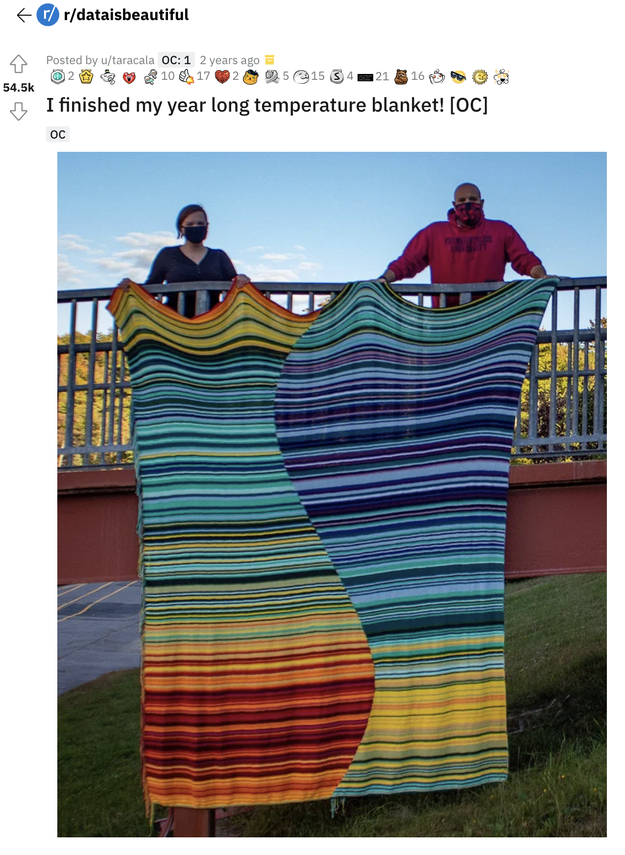
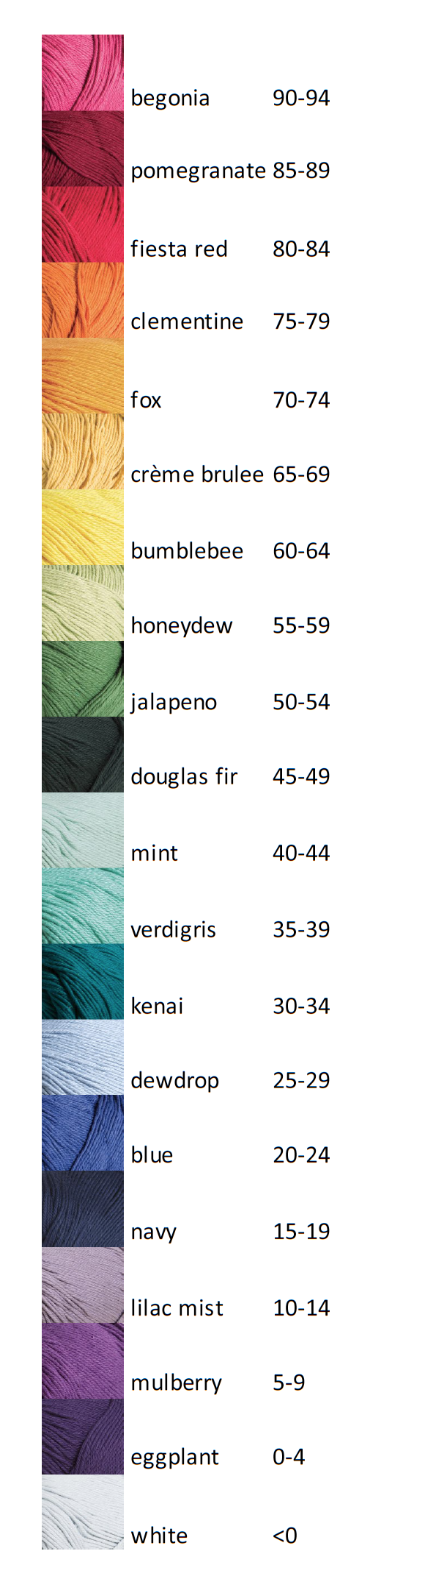
Meanwhile, on the internet:
Color to temperature (°F)
Daily low temperature
September 21, 2019
https://www.reddit.com/r/dataisbeautiful/comments/ixvyfw/i_finished_my_year_long_temperature_blanket_oc/
Daily high temperature
Proportion day to night
September 20, 2020

Slide 4
Very cool!
But needs more library…
Meanwhile, on the internet:
Color to temperature (°F)
Daily low temperature
September 21, 2019
https://www.reddit.com/r/dataisbeautiful/comments/ixvyfw/i_finished_my_year_long_temperature_blanket_oc/
Daily high temperature
Proportion day to night
September 20, 2020

Slide 5

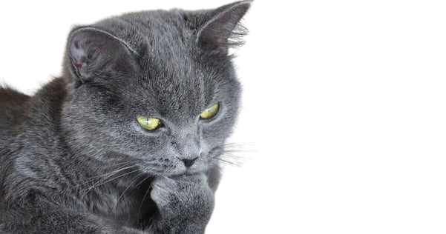

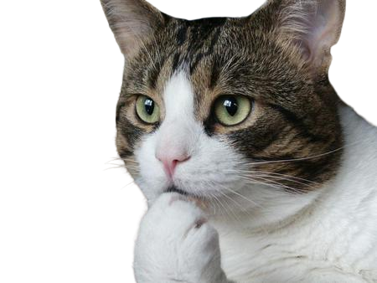
That got us thinking…
(scene re-enacted)

Slide 6
Thank you

